Slide 1

Chaos Architecture
A Cloud Native Availability Model
Adrian Cockcroft
@adrianco
AWS VP Cloud Architecture Strategy

Slide 2
Pathway for Digital Transformation
Speed
Scale
Strategic
!
Time to Value
Distributed Optimized Capacity
Critical Workloads Datacenter Replacement

Slide 3
As an architect my role wasn’t to tell other people what the architecture should be.
It was to ask awkward questions…

Slide 4
What should your system do when something fails?
Stop?
Carry on with reduced functionality?

Slide 5
Permissive failure, what’s the real cost of continuing?
What should IT do when something fails?
If a permissions look up fails, should you stop or continue?
See Memories, Guesses, and Apologies by Pat Helland

Slide 6
How often do you failover apps to it?
If a permissions look up fails, should you stop or continue?
Do you have a backup datacenter?
How often do you failover the whole datacenter at once?
“Availability Theater”

Slide 7
A fairy tale…
Once upon a time, in theory, if everything works perfectly, we have a plan to survive the disasters we thought of in advance.
How did that work out?

Slide 8
Forgot to renew domain name…
SaaS vendor
Entertainment site
Didn’t update security certificate and it expired…
Datacenter flooded in hurricane Sandy…
Finance company, Jersey City
Whoops!
YOU, tomorrow

Slide 9
“You can’t legislate against failure, focus on fast detection and response.”
—Chris Pinkham

Slide 10
What is supposed to happen when part of the system fails?
How do you know that your system works at all?
How is it supposed to recover after the failure goes away?

Slide 11

The Network Is Reliable ACM Queue 2014
Bailiss & Kingsbury
@pbailiss @aphyr

Slide 12
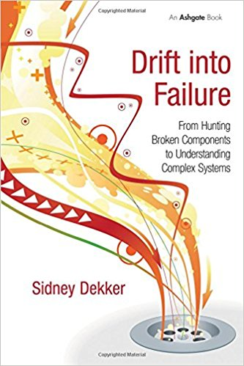
Drift Into Failure
Sydney Dekker

Slide 13
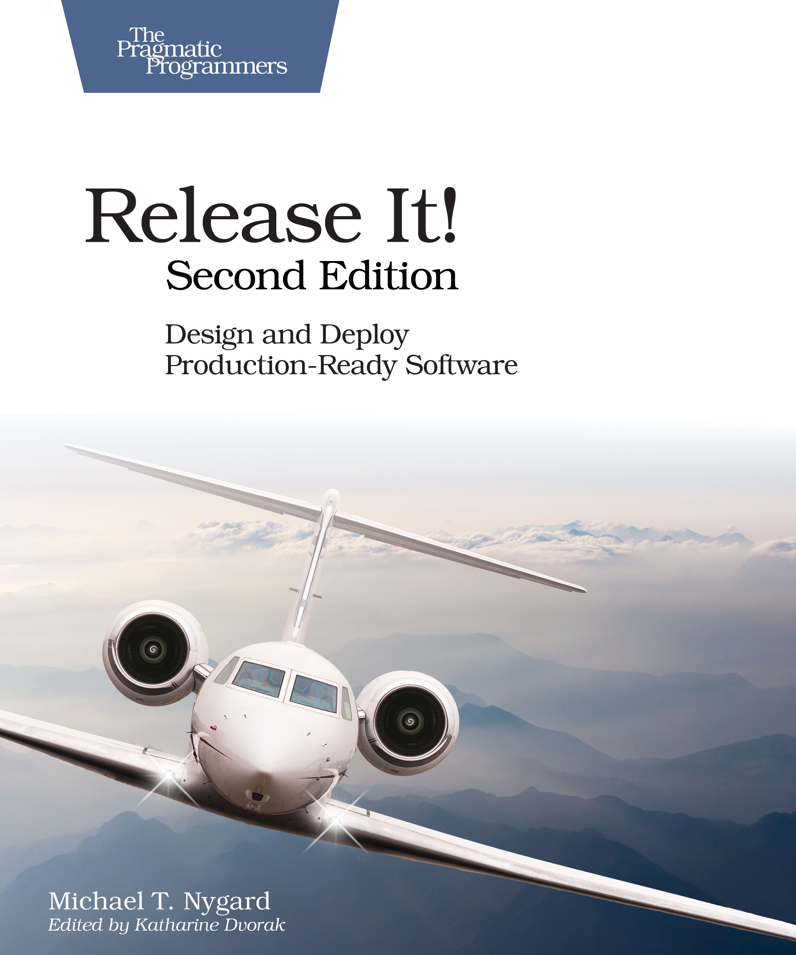
Release It! Second Edition 2017
Michael Nygard

Slide 14
Chaos Architecture
Four layers
Two teams
An attitude

Slide 16
Infrastructure and Services
No single point of failure

Slide 17
Infrastructure

Slide 19

Switching and Interconnecting
Data replication
Traffic routing
Avoiding issues
Anti-entropy recovery

Slide 20
Switching and Interconnecting
Data replication
Traffic routing
Avoiding issues
Anti-entropy recovery

Slide 21
Switching and Interconnecting
Data replication
Traffic routing
Avoiding issues
Anti-entropy recovery

Slide 22
Switching
Infrastructure

Slide 24
!
Application
Failures
App
Error returns
Slow response
Network partition

Slide 25
Application
Switching
Infrastructure

Slide 27
People
Whoops!
I wonder why it did that?
Let’s reboot it.
Now it’s really hosed
Unexpected application behavior often causes people to intervene and make the situation worse

Slide 28
People Training
!
A fire drill is a boring routine where we make everyone take the stairs and assemble in the parking lot

Slide 29
People Training
Fire drills save lives in the event of a real fire, because people are trained how to react

Slide 30
People
Who runs the “fire drill” for I.T.?
Application
Switching
Infrastructure

Slide 31
People
Application
Chaos Engineering Team
Switching
Infrastructure

Slide 32
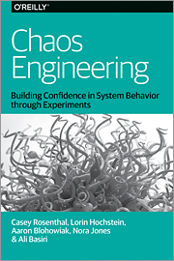
People
Application
Chaos Engineering Team
Switching
Infrastructure

Slide 33
People
Application
Tools
Chaos Engineering Team
Switching
Infrastructure

Slide 34


Tools
Game days
People
Simian Army
Application
chaostoolkit
Chaos Engineering Team
Switching
ChAP
Gremlin
Infrastructure

Slide 35
People
Application
Tools
Chaos Engineering Team
Switching
Security Red Team
Infrastructure

Slide 36
People
Application
Tools
Tools
Chaos Engineering Team
Switching
Security Red Team
Infrastructure

Slide 37
Tools
People
Safestack AVA
Application
Infection
Monkey
Tools
Switching
Chaosslingr
Chaos Engineering Team
Security Red Team
AttackIQ
Infrastructure
SafeBreach

Slide 38
Chaos
Architecture
People
Application
Four layers
Two teams
An attitude— Break it to make it better
Tools
Tools
Chaos Engineering Team
Switching
Security Red Team
Infrastructure

Slide 39
Break it to make it safer
For more on the “New View” of Safety see:
Todd Conklin’s Pre-accident podcast
John Allspaw’s stella.report

Slide 40

Synoptic Illegibility
You can’t write down exactly what really happens, so you can’t write a synopsis or run-book. System safety is an emergent property.
The Safety Anarchist Sydney Decker

Slide 41
Failures are a system problem— lack of safety margin
Not something with a root cause of component or human error

Slide 42
Blindfolded on a cliff edge, what would you do?

Slide 43
Hypothesis testing
We think we have safety margin in this dimension, let’s carefully test to be sure
In production
Without causing an issue

Slide 44
Chaos testing ensures that you have:
Experienced Staff
Robust Applications
Dependable Switching Fabric
Redundant Service Foundation

Slide 45
Cloud Native Chaos in Practice
Mechanisms for AWS and Kubernetes

Slide 46
AWS Mechanisms
Amazon Aurora DB Cluster Fault Injection Queries
Crash master or replica
Fail a replica
Disk failure or congestion
ALTER SYSTEM SIMULATE percentage_of_failure PERCENT READ REPLICA FAILURE [ TO ALL | TO "replica name" ] FOR INTERVAL quantity { YEAR | QUARTER | MONTH | WEEK | DAY | HOUR | MINUTE | SECOND };
https://docs.aws.amazon.com/AmazonRDS/latest/UserGuide/AuroraMySQL.Managing.FaultInjectionQueries.html

Slide 47
AWS Mechanisms
IAM Region Restriction
Simulate regional API issues by changing the list of permitted regions
{ "Sid": "RegionRestricted", "Effect": "Allow", "Action": “*”, "Resource": "*", "Condition": {"StringEquals": {"aws:RequestedRegion": [ "eu-west-1"]}}
}
https://aws.amazon.com/blogs/security/easier-way-to-control-access-to-aws-regions-using-iam-policies/

Slide 48
Kubernetes Mechanisms
Gremlin Attacks
Gremlin runs a daemon on each node that manages and induces failures and network blocking
https://www.gremlin.com/community/tutorials/how-to-install-and-use-gremlin-with-kubernetes/

Slide 49
Kubernetes Mechanisms
Open Source Chaos Toolkit
Chaos Toolkit defines experiments, executes them and generates reports – chaostoolkit.org
Drivers for Gremlin, EC2 and Kubernetes etc.
Included in Kubernetes on AWS Workshop
https://medium.com/chaos-toolkit/make-applications-more-resilient-on-kubernetes-by-adding-chaos-engineering-70a4c282609f

Slide 50
CNCF Chaos Working Group
Open Source Chaos Toolkit
Use EC2 driver to impact k8s control plane
Use k8s driver to impact applications
Introduction https://medium.com/chaosiq/a-pinch-of-chaos-engineering-at-kubecon-604614b73871
Image from https://kubecloud.io/ha-kubernetes-cluster-on-aws-kops-makes-it-easy-2337806d0311

Slide 51
Expensive and custom disaster recovery is being replaced by low cost, portable, automated chaos engineering.

Slide 52
Chaos Architecture
A Cloud Native Availability Model
Adrian Cockcroft
@adrianco
AWS VP Cloud Architecture Strategy

